Slide 1
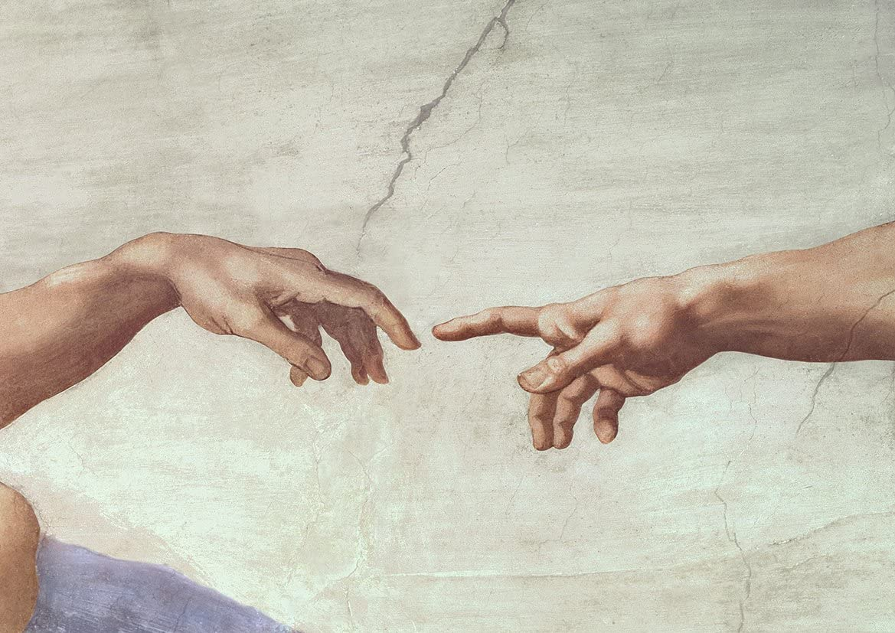
B.C. OLD TESTAMENT
A.D. NEW TESTAMENT
GOD as Creator
GOD as Son
(Leader, Intimate Friend for ALL)
WORD of GOD
Love Me, TRUST Me, TALK to Me… face-to-face, Hear Me, See Me, Touch Me, Be with Me
Now – GO MAKE DISCIPLES!
Man TOUCHES FACE of GOD
(Intimate Friend for Some: Ex: 33)
DIVINITY of GOD
Love Me, Trust Me, SEE My Glory
Now – SPREAD the WORD!
Man SEES GLORY of GOD
One Holy, Catholic, Apostolic Church
One Holy Kingdom
PEOPLE: What is your NAME?
Let us: HEAR You, SEE You… FACE-to-FACE, TOUCH You
JESUS: HIS name is FATHER
SEE Me, See Him (Face-to-face); HEAR Me, Hear His WORD; KNOW Me, Know Him by smell, touch, taste (Mass, Eucharist)
One Holy Tribe
One Holy Nation
Jesus
Adam/Eve
Abraham
One Holy Couple
One Holy Family
Noah
Moses
David
PENTECOST
GOD as Spirit
(Gift Bearer, Life Giver, Intimate Friend for ALL)
SPIRIT of God
LOVE ME, TRUST ME, RECEIVE ME!
Man BECOMES Sons and Daughters of GOD!
PEOPLE: What is your NAME?
Let us: HEAR Your Voice, SEE You… Face-to-Face,
TOUCH You, Be with You
Now, GO TELL THE WORLD!
Emmaus Road www.lighthouseideas.org 04-01-21
Notes:
CARING – Prayer, Trust, Listening, Support
DISCOVERY – Current/Past Spiritual Journey (Ecclesial, Internal Personal Journey; Current/Past Thresholds: Trust, Curiosity, Openness, Seeking, intentional Discipleship)
SHARING – Their story; Jesus Story; Your story
PLANNING & OPPORTUNITIES– What does the Emmaus Road look like for this person/for your? What resources/support is available? What is plan? Ex: Alpha? (Use Rome Sweet Home ideas
OBSTACLES/DISTRATIONS – Identify the obstacles or distractions that could prevent someone from growing into discipleship
DISCIPLESHIP – Cha rism (Called and Gifted) – know resources and opportunities available

